Slide 1
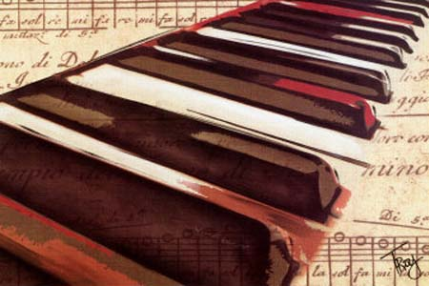
Music History Trivia

Slide 2
Directions
4 Rounds
1. Write your answer
2. Multiple Choice
3. Name these composers
4. Name that tune
Have one person from your group write down the answer after each question
Each correct answer counts as 1 point
Add up your points at the end of each round

Slide 3
Write Your Answer
1. What was the first song to be performed in outer space?
Happy Birthday
2. What band was the first to sell one million records?
The Glenn Miller Orchestra
3. What classical composer wrote the majority of his music when he was deaf?
Beethoven
4. What composer once wrote a piece that takes 18 hours to perform?
Erik Satie

Slide 4
Multiple Choice
5. What is the minimum number of musicians a band must have in order to be considered a “Big Band”?
a. 5
b. 10
c. 7
d. 20
6. What composer learnt to play the piano before he could read?
a. Beethoven
b. Chopin
c. Mozart
d. Bartok

Slide 5
Multiple Choice
7. What City opera house does the “Phantom of the Opera” prowl?
a. London
b. Paris
c. Vienna
d. Berlin
8. What instrument was known as the SACKBUT?
a. Trumpet
b. Saxophone
c. oboe
d. trombone

Slide 6
Name These Composers

Slide 7
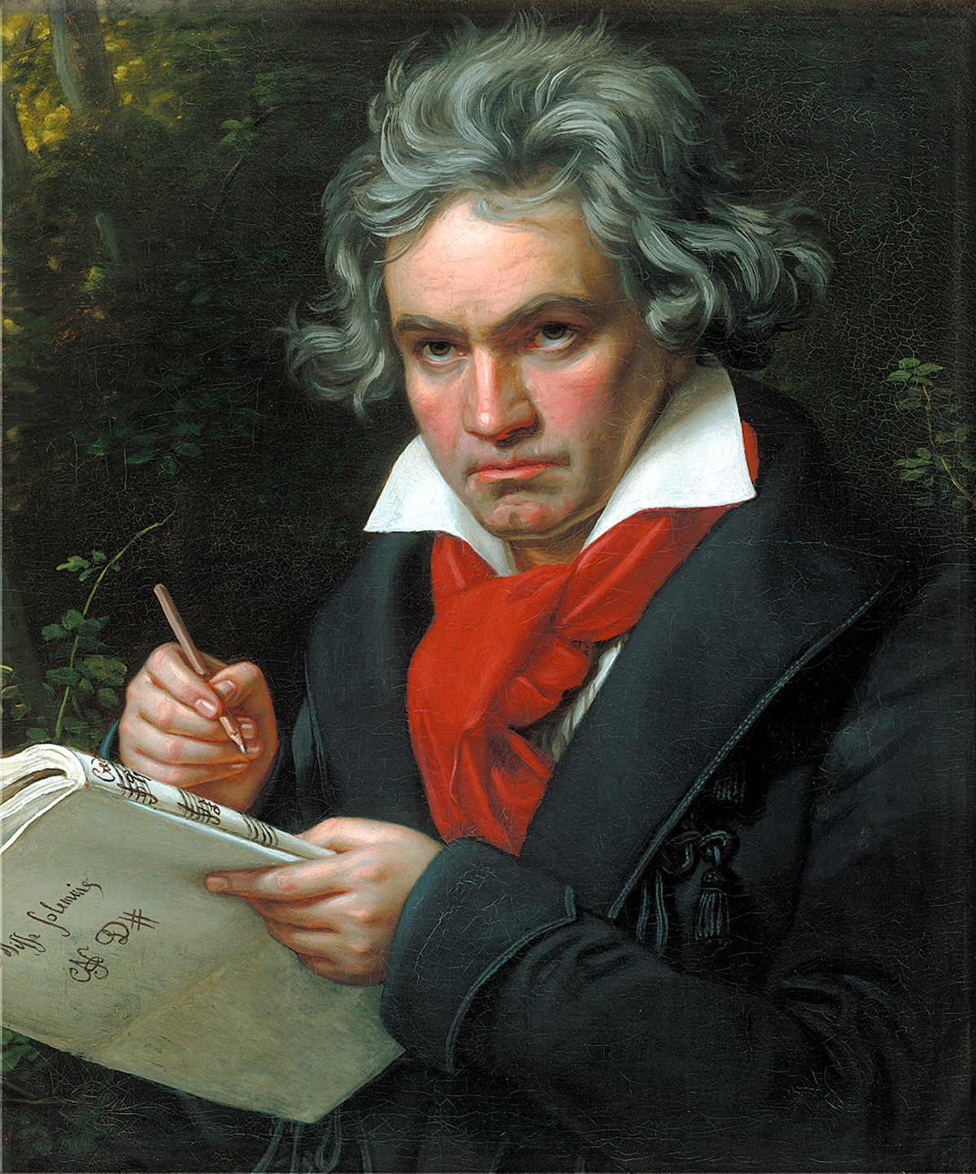
One of the most influential composers straddling the 18th century “classical” and 19th century “romantic” movements he continued to compose after becoming deaf.
Who is this composer?

Slide 8
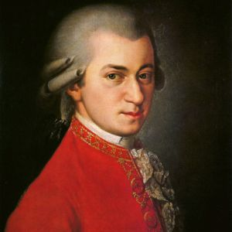
This photo dates around 1780, 11 years before his premature death only a few weeks before the premier of his opera “The Magic Flute”
Who is this composer?

Slide 9
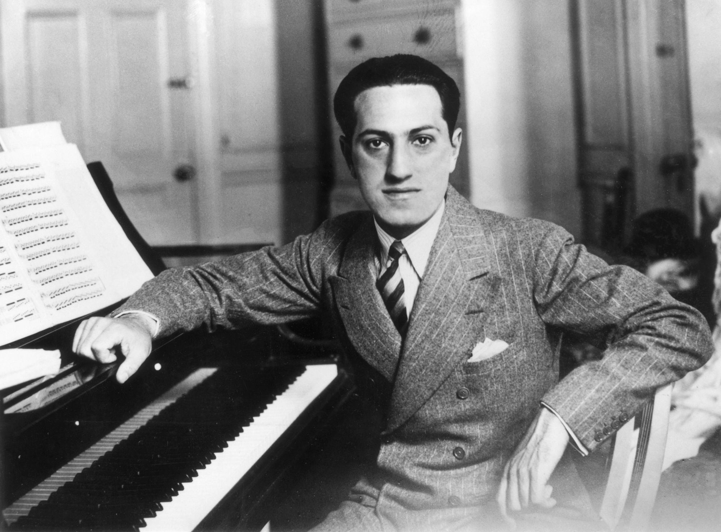
American composer and pianist who wrote Porgy and Bess and was a songwriter for New York’s Tin Pan Alley.
Who is this composer?

Slide 10
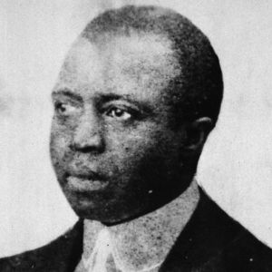
African-American composer and pianist who wrote ragtime pieces such as the “Maple Leaf Rag” and “ The Entertainer”.
Who is this composer?

Slide 11
Name That Tune Artist & Song Name

